Slide 2
SIEM-EDR Disclaimer
https://www.linkedin.com/company/wocsa/ https://www.youtube.com/@WOCSA-rx2mn/
Disclaimer
The following demonstration is for educational purposes only.
We do not promote or encourage illegal activities.
Knowing your enemy is a half-won battle
La connaissance n'est réellement profitable que lorsqu'elle est partagée
https://github.com/wocsa

Slide 3
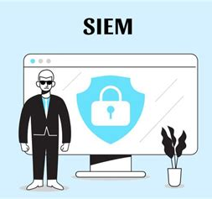
SIEM-EDR Agenda
https://www.linkedin.com/company/wocsa/ https://www.youtube.com/@WOCSA-rx2mn/
What is a SIEM?
What is an EDR?
SIEM vs EDR
Example of an open source SIEM-EDR: Wazuh
https://github.com/wocsa

Slide 4
What is a SIEM?
10/11/2024

Slide 5
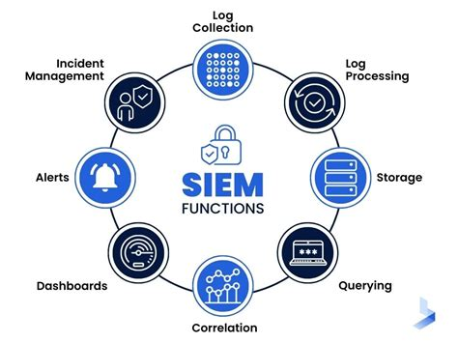
SIEM-EDR What is a SIEM?
https://www.linkedin.com/company/wocsa/ https://www.youtube.com/@WOCSA-rx2mn/
Definition: Overview of SIEM as a solution combining security information management (SIM) and security event management (SEM) to aggregate, analyze, and manage logs.
Key Functions:
Real-time event monitoring and alerts.
Log aggregation and normalization.
Threat detection and incident response.
Benefits: Improved security visibility, regulatory compliance, and rapid threat detection across a network.
https://github.com/wocsa

Slide 6
What is an EDR?
10/11/2024

Slide 7
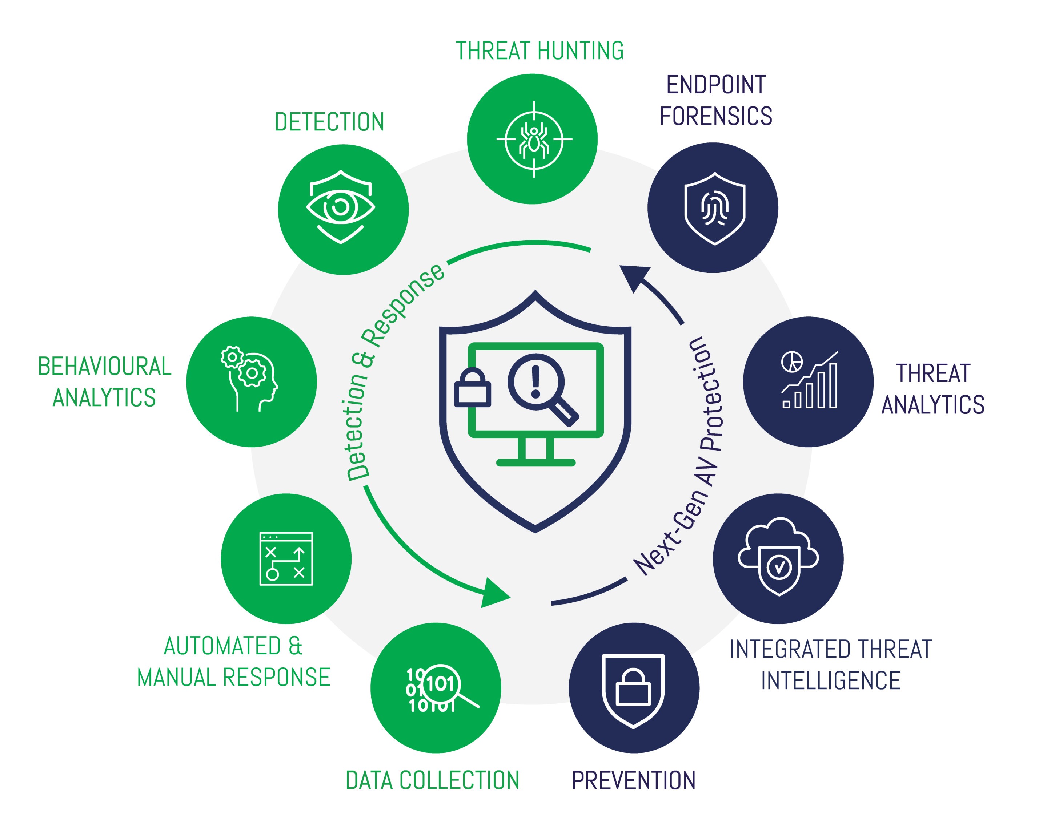
SIEM-EDR What is an EDR?
https://www.linkedin.com/company/wocsa/ https://www.youtube.com/@WOCSA-rx2mn/
Definition: Overview of EDR, focusing on endpoint monitoring, detection, and response.
Core Functions:
Continuous monitoring of endpoint activity.
Threat detection on endpoints (e.g., laptops, servers, mobile devices).
Rapid containment and response capabilities.
Benefits: Enhanced endpoint security, improved incident response, and prevention of lateral movement in attacks.
https://github.com/wocsa

Slide 8
SIEM vs EDR
10/11/2024

Slide 9
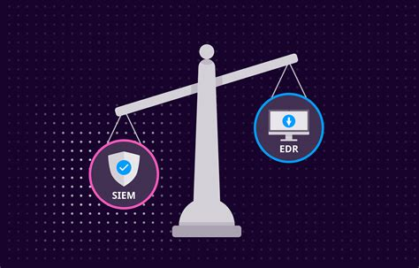
SIEM-EDR SIEM vs EDR
https://www.linkedin.com/company/wocsa/ https://www.youtube.com/@WOCSA-rx2mn/
Comparing Approaches:
SIEM: Holistic view of network-wide events and logs from multiple sources.
EDR: Focused on endpoint-specific security and response actions.
Complementary Roles: SIEM and EDR work together to provide comprehensive security coverage.
https://github.com/wocsa

Slide 10
Example of an open source SIEM-EDR: Wazuh
10/11/2024

Slide 11

SIEM-EDR Wazuh
https://www.linkedin.com/company/wocsa/ https://www.youtube.com/@WOCSA-rx2mn/
Key Features:
Log data analysis and correlation.
Intrusion detection and vulnerability assessment.
File integrity monitoring and compliance checks.
Endpoint detection and response capabilities.
Advantages:
Cost-effective for small businesses and personal use.
Flexibility and customization with open-source architecture.
https://github.com/wocsa

Slide 12
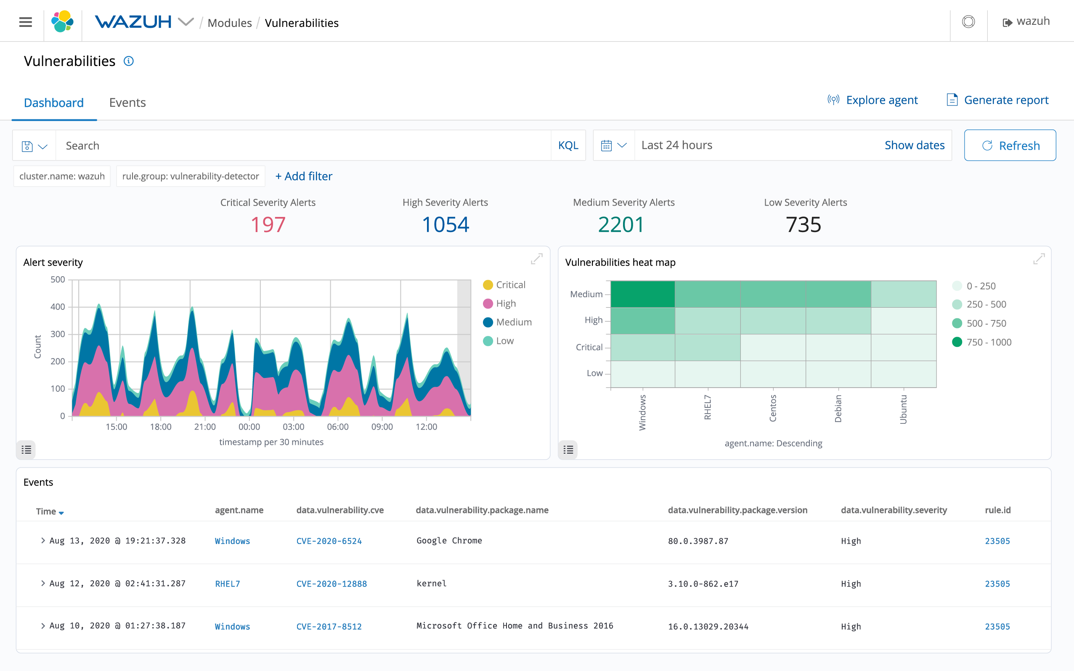
SIEM-EDR Wazuh Alerts
https://www.linkedin.com/company/wocsa/ https://www.youtube.com/@WOCSA-rx2mn/
https://github.com/wocsa

Slide 13

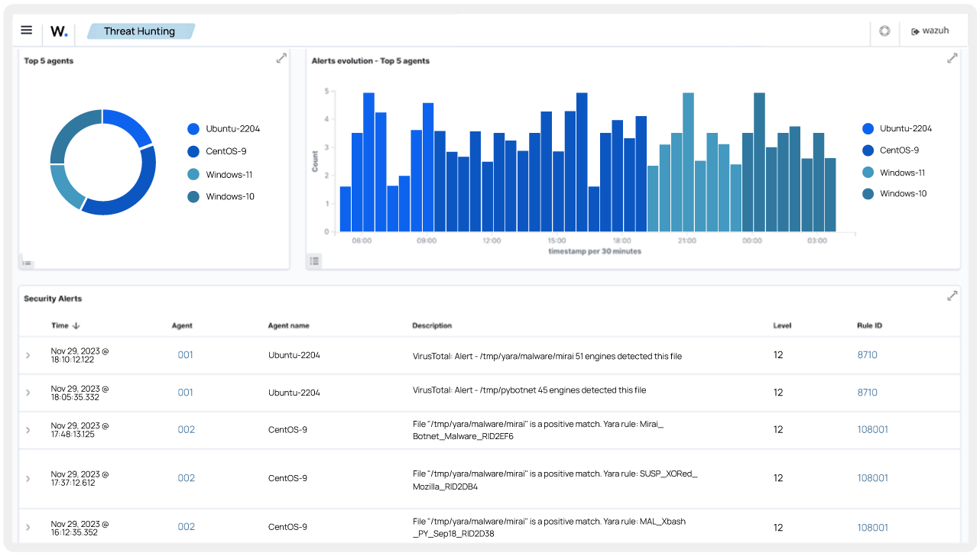
SIEM-EDR Wazuh Threat Hunting
https://www.linkedin.com/company/wocsa/ https://www.youtube.com/@WOCSA-rx2mn/
https://github.com/wocsa

Slide 14
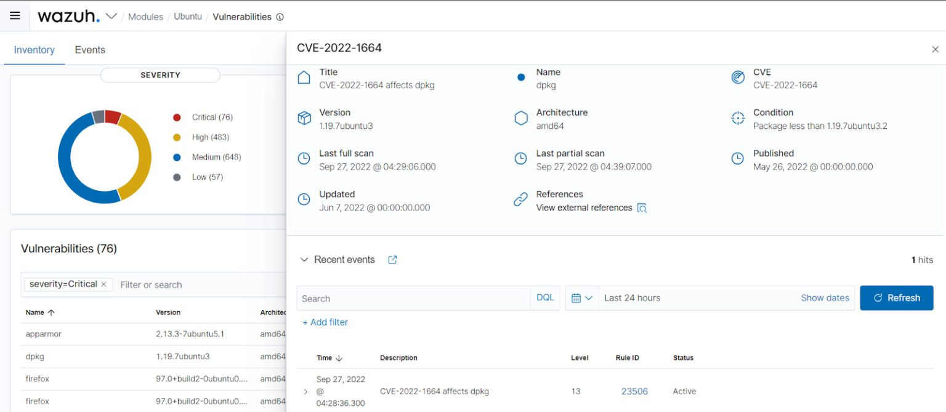
SIEM-EDR Wazuh Vulnerability Scanner
https://www.linkedin.com/company/wocsa/ https://www.youtube.com/@WOCSA-rx2mn/
https://github.com/wocsa

Slide 15










Join us to change the digital world: https://www.helloasso.com/associations/wocsa/adhesions/bulletin-d-adhesion-2 Please provide your feedback for our quality check process: https://www.wocsa.org/qcheck.php
10/11/2024
www.wocsa.org
@wocsa
@wocsa_asso
@wocsa
contact@wocsa.org
Join Us!
@WOCSA-rx2mn
https://discord.gg/pDunje3tpb

